Slide 1


The Mix challenge
Byte Guru
Notes:
System Automated Management

Slide 2
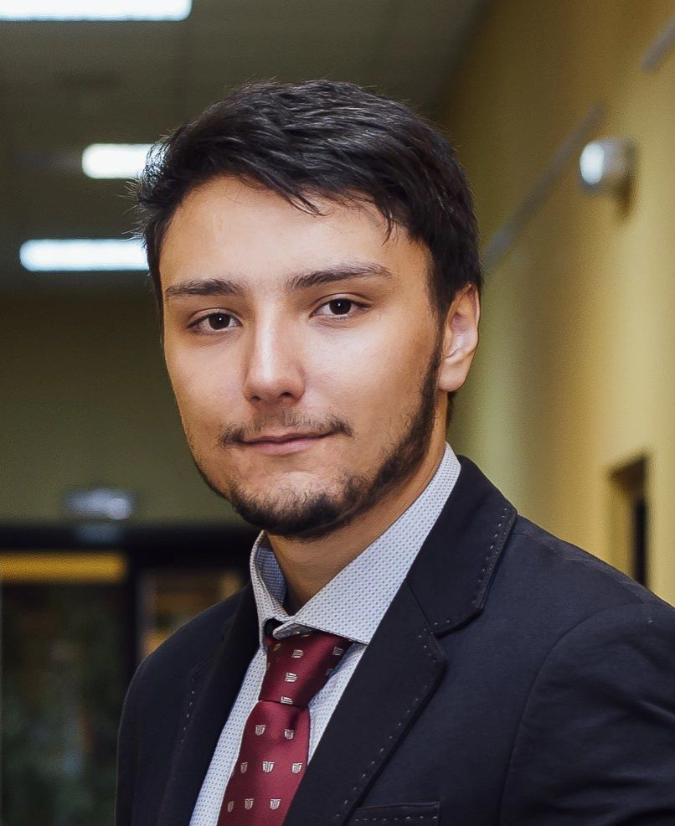

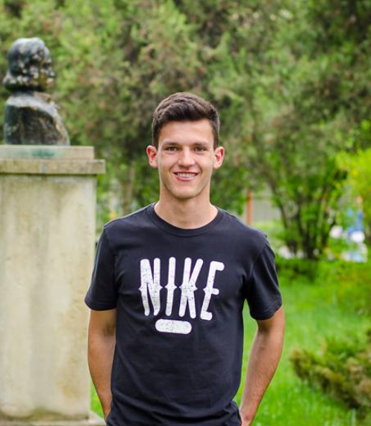
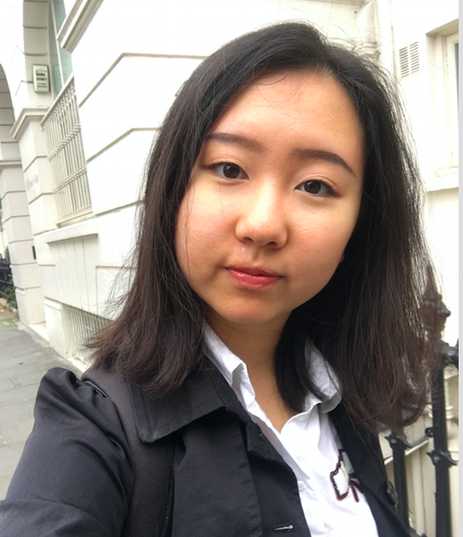

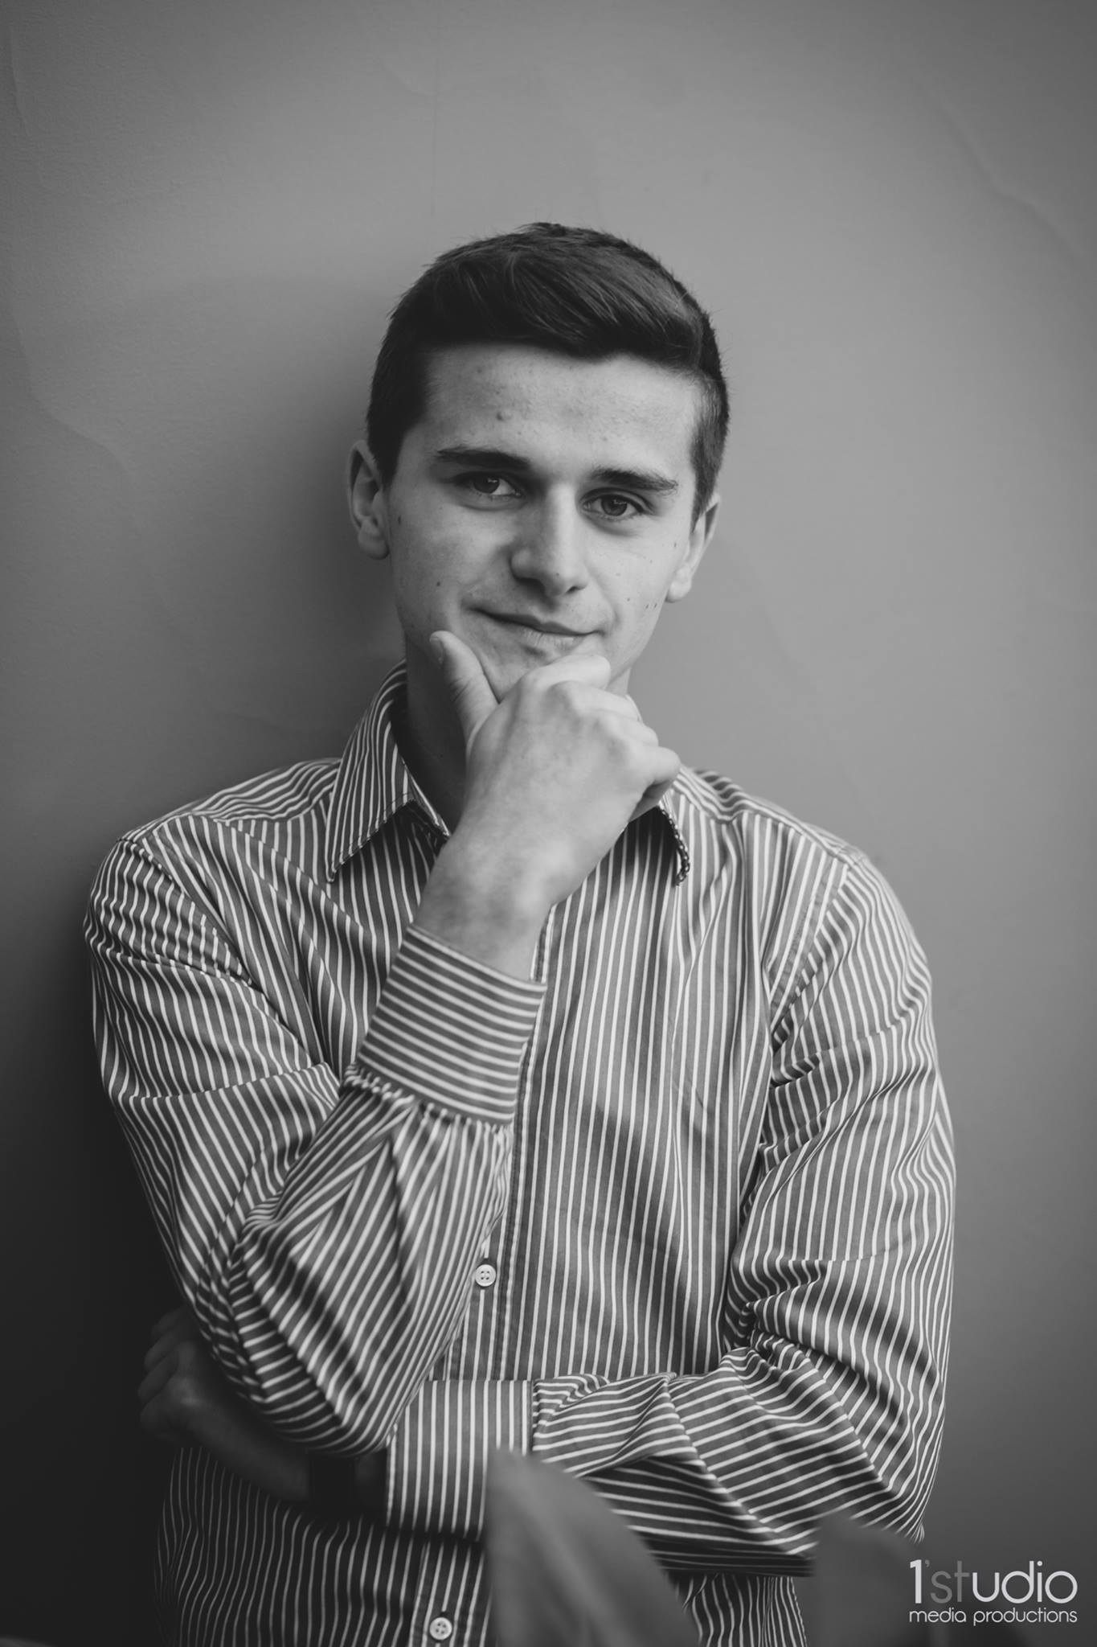
Mihai
Cosmin
Viorel
Beniamin
Jieni
Gabriel

Slide 3

The problem
How to deliver best contents to user more effectively

Slide 4
Causes
Limited staff, long waiting time
Lots of valuable contents to be better delivered

Slide 5
How can we solve this?
Keep them engaged

Slide 6
Meet our friend SAM
😉
SAM (System Automation Managed bot) temporarily shares load with The Mix staff

Slide 7
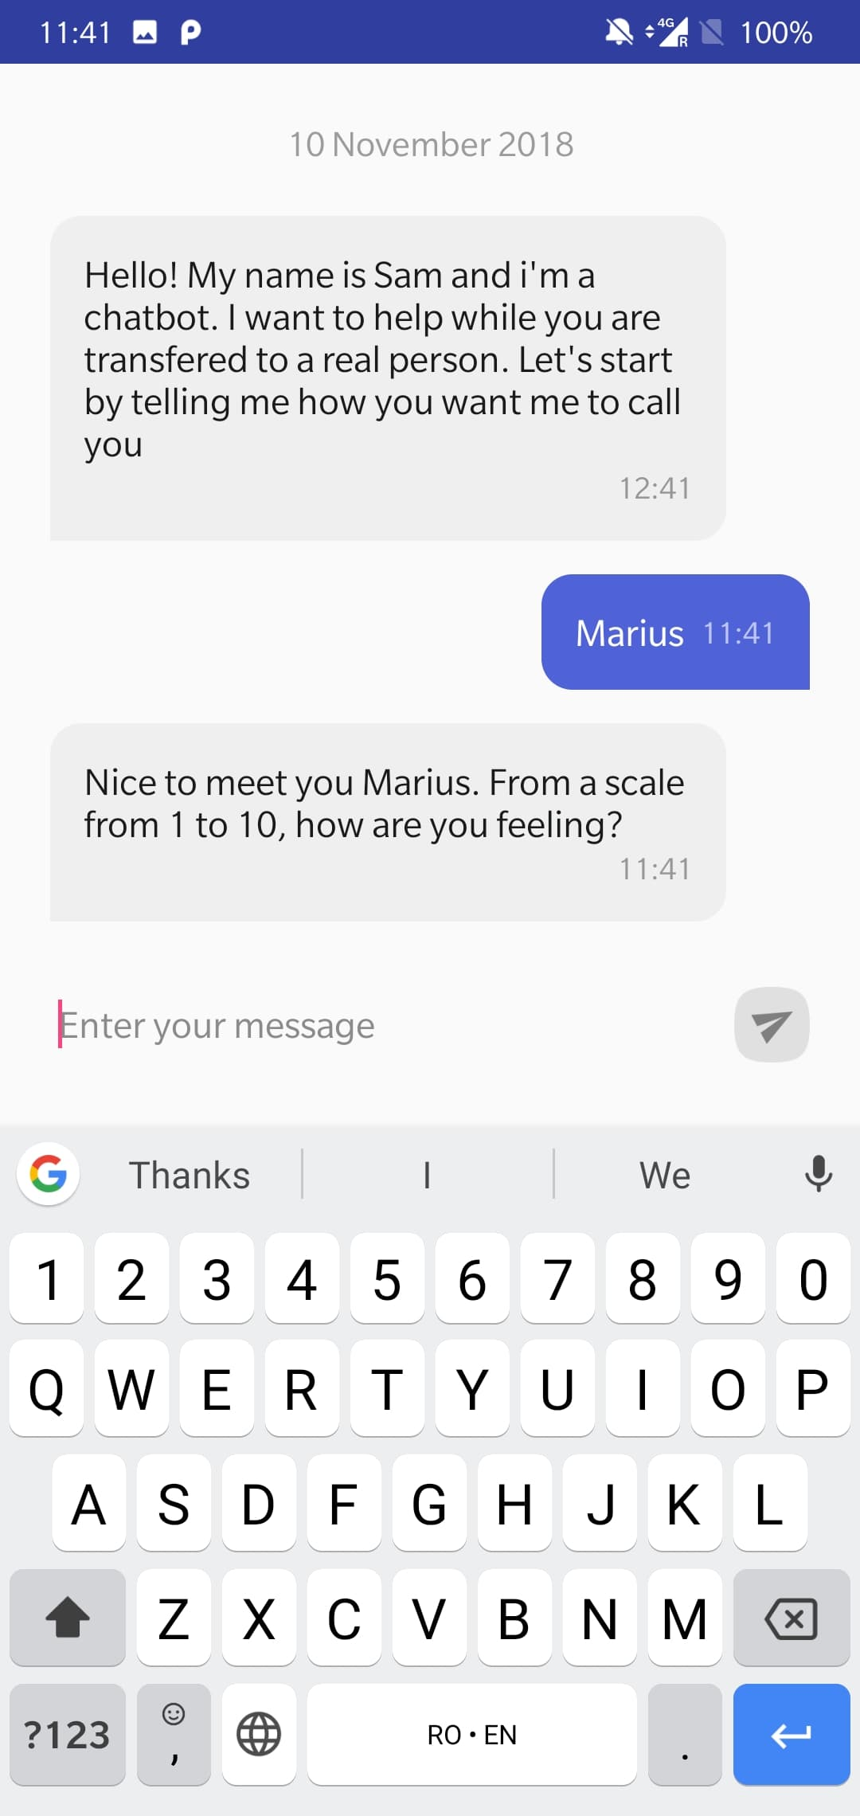
SAM is with you ANYTIME at ANY PLACE ☺

Slide 8
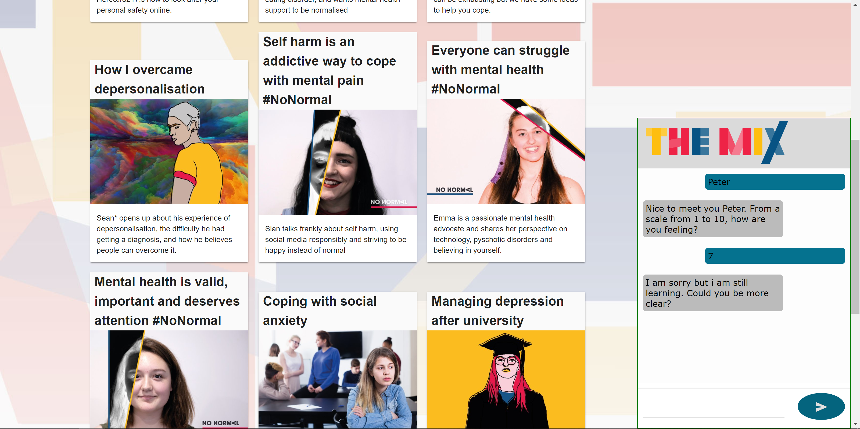

Slide 9
Can we use the collected information?
Notes:
Can we use the collected information from the users that gave it to us.

Slide 10
Our process
Forums
Server
Articles
User

Slide 11
What we do
Value added
Efficiency for staff working hours
Automated conversation
User engagement during waiting time
Personalize service
Recommended articles/forums
Link people with empathy

Slide 12
More user getting helped
Create connection between those in need
More traffic

Slide 13
Demo

Slide 14

Demo

Slide 15
Future
UI UX
Harness of the power of AI and make SAM smarter
Better distribution of system
Multiple languages
Gamification
Text based alert

